Slide 1
Introduction to the Internet
CPS 514 / ECE 558
(many slides courtesy of Nick Feamster)

Slide 2
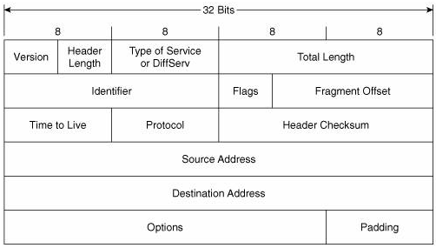
The Internet Protocol in a Nutshell
(somewhat simplified)
Every network interface has an IP address, e.g., 128.2.205.42
Service model: the network will make a best effort to deliver each individual datagram to the address specified in the destination address field in its header.

Slide 3
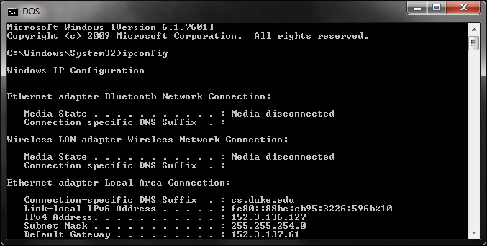
Discovering My Laptop’s IPv4 Address
On Windows, use program ipconfig. On Mac or Linux, use ifconfig or ip.
Only my wired ethernet interface has an IP address (152.3.136.127.)
Page <number>

Slide 4
Transmission Control Protocol (TCP)
Built on top of IP
Provides reliable in-order delivery of data
Checksums datagram contents to detect corruption
Retransmits lost and corrupted datagrams
Reorders out-of-order datagrams
End points cooperate to limit congestion

Slide 5
Today’s Reading
Design Philosophy of the DARPA Internet Protocols. Dave Clark, 1988.
Conceptual Lessons
  Design principles/priorities were developed for a certain type of network. As the Internet evolves, we feel the sting of some of these choices.
Technical Lessons
  Packet switching
  Fate Sharing/Soft state

Slide 6
Fundamental Goal
“to develop an effective technique for multiplexed utilization of existing interconnected networks”
Multiplexing (sharing)
  Shared use of a single communications channel
Existing networks (interconnection)
  The Internet is a network of networks

Slide 7
Fundamental Goal: Sharing
Packet Switching
No connection setup
Forwarding based on destination address in packet
Efficient sharing of resources
Tradeoff: Resource management is potentially more difficult.

Slide 8
Stopping Unwanted Traffic is Hard
The IP service model makes it easy for anyone to send traffic to anyone else… even if they don’t want it!
cnn.com

Slide 9
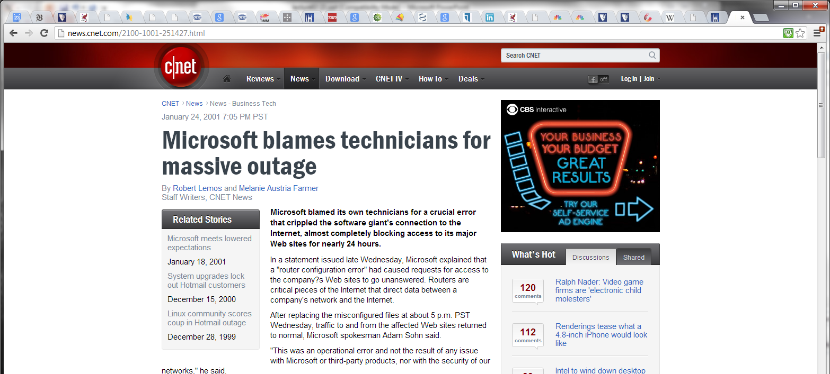
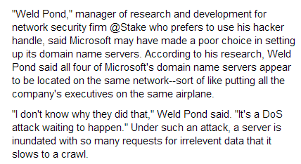
DNS Vulnerability
January 2001

Slide 10
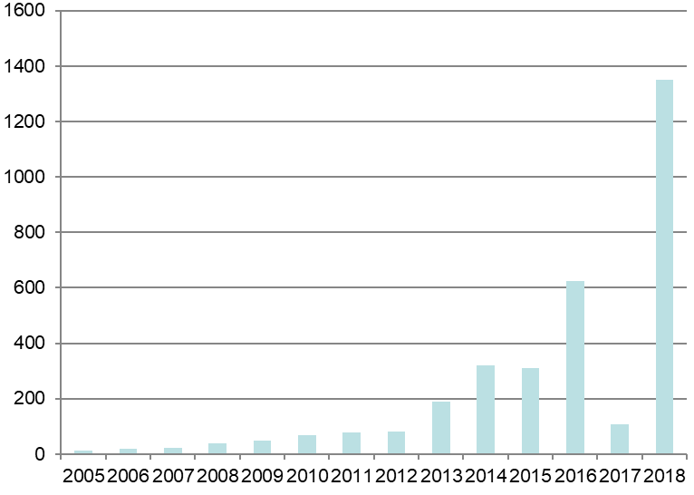
Largest Distributed Denial-of-Service (DDOS) Attacks by Year
GitHub
Gbps
Krebs

Slide 11
Research: Stopping Unwanted Traffic
Possible Defenses
Throw more capacity at the problem: Expensive, but current state of the art
Monitoring + Filtering: Detect DDoS attack and install filters to drop traffic.
Capabilities: Only accept traffic that carries a “capability”

Slide 12
Alternatives to Packet Switching
Circuit Switching: Signaling protocol sets up entire path out-of-band. (e.g., the phone network)
Virtual Circuits: Hybrid approach. Packets carry “tags” to indicate path, forwarding over IP (e.g., ATM)
Source routing: Complete route is contained in each data packet

Slide 13
An Age-Old Debate
Circuit Switching
Resource control, accounting, ability to “pin” paths, etc.
Packet Switching
Sharing of resources, soft state (good resilience properties), etc.
It is held that packet switching was one of the Internet’s greatest design choices.
Of course, there are constant attempts to shoehorn the best aspects of circuits into packet switching.
Examples: Capabilities, MPLS, ATM, IntServ QoS, etc.

Slide 14
The Design Goals of Internet, v1
Interconnection/Multiplexing (packet switching)
Resilience/Survivability (fate sharing)
Heterogeneity
  Different types of services
  Different types of networks
Distributed management
Cost effectiveness
Ease of attachment
Accountability
Decreasing
Priority
“This set of goals might seem to be nothing more than a checklist of all the desirable network features. It is important to understand that these goals are in order of importance, and an entirely different network architecture would result if the order were changed.”
These goals were prioritized for a military network.
Should priorities change as the network evolves?

Slide 15

Fundamental Goal: Interconnection
Need to interconnect many existing networks
Hide underlying technology from applications
Decisions:
  Network provides minimal functionality
  “Narrow waist”
email WWW phone...
SMTP HTTP RTP...
TCP UDP…
IP
ethernet PPP…
CSMA async sonet...
copper fiber radio...
Applications
Technology
Tradeoff: No assumptions, no guarantees.

Slide 16
The “Curse of the Narrow Waist”
IP over anything, anything over IP
  Has allowed for much innovation both above and below the IP layer of the stack
  An IP stack gets a device on the Internet
Drawback: very difficult to make changes to IP
  But…people are trying

Slide 17

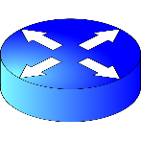
Interconnection: “Gateways”
Interconnect heterogeneous networks
No state about ongoing connections
  Stateless packet switches
Generally, router == gateway

Slide 18
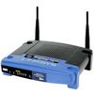
Interconnection: “Gateways”
But, we can think of your home router/NAT as also performing the function of a gateway
192.168.1.51
68.211.6.120:50878
Home
Network
Internet
192.168.1.52
68.211.6.120:50879

Slide 19
Network Address Translation
For outbound traffic, the gateway:
  Creates a table entry for computer's local IP address and port number
  Replaces the sending computer's non-routable IP address with the gateway IP address.
  replaces the sending computer's source port
For inbound traffic, the gateway:
  checks the destination port on the packet
  rewrites the destination address and destination port those in the table and forwards traffic to local machine

Slide 20
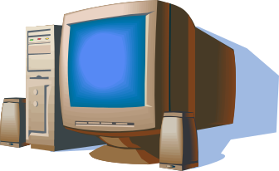
NAT Traversal
Problem: Machines behind NAT not globally addressable or routable. Can’t initiate inbound connections.
One solution: Simple Traversal of UDP Through NATs
  STUN client contacts STUN server
  STUN server tells client which IP/Port the NAT mapped it to
  STUN client uses that IP/Port for call establishment/incoming messages
Home
Network 1
Home
Network 2
Relay node
More next time.

Slide 21
Soft State
Goal #2: Survivability
Network should continue to work, even if some devices fail, are compromised
State that can be regenerated if needed.
E.g., switch and router tables.
Fate Sharing (from paper)
``The fate-sharing model suggests that it is acceptable to lose the state information associated with an entity if, at the same time, the entity itself is lost.’’
E.g., TCP connection status
Unsaid: State should not be lost if the entity is not lost.
Some reversals of this trend:
NAT, Software Defined Networking (SDN)

Slide 22
Goal #3: Heterogeneous Services
TCP/IP designed as a monolithic transport
  IP for forwarding
  TCP for flow control, reliable delivery
Became clear that not every type of application would need reliable, in-order delivery
  Example: Voice and video over networks
  Example: DNS
  Why don’t these applications require reliable, in-order delivery?
  Narrow waist: allowed proliferation of transport protocols

Slide 23
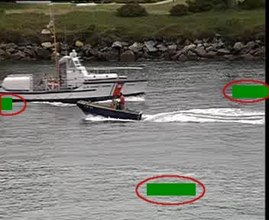
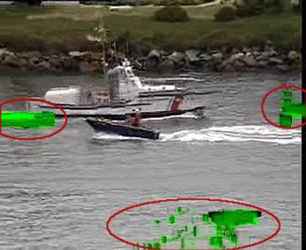
Topic: Voice and Video over Networks
Deadlines: Timeliness more important than 100% reliability.
Propagation of errors: Some losses more devastating than others
Loss in “Anchor” Frame (I-Frame)
Propagates to “Dependent” Frames
(P and B-Frames)

Slide 24
Goal #3b: Heterogeneous Networks
Build minimal functionality into the network
  No need to re-engineer for each type of network
“Best effort” service model.
  Lost packets
  Out-of-order packets
  No quality guarantees
  No information about failures, performance, etc.
Tradeoff: Network management more difficult

Slide 25
Goal #4: Distributed Management
Many examples:
Addressing (ARIN, RIPE, APNIC, etc.)
Public-Key Infrastructure (TLS)
Naming (DNS)
Routing (BGP)
No single entity in charge.
Allows for organic growth, scalable management.
Tradeoff: No one party has visibility/control.

Slide 26
No Owner, No Responsible Party
“Some of the most significant problems with the Internet today relate to lack of sufficient tools for distributed management, especially in the area of routing.”
Hard to figure out who/what’s causing a problem
Worse yet, local actions have global effects…

Slide 27
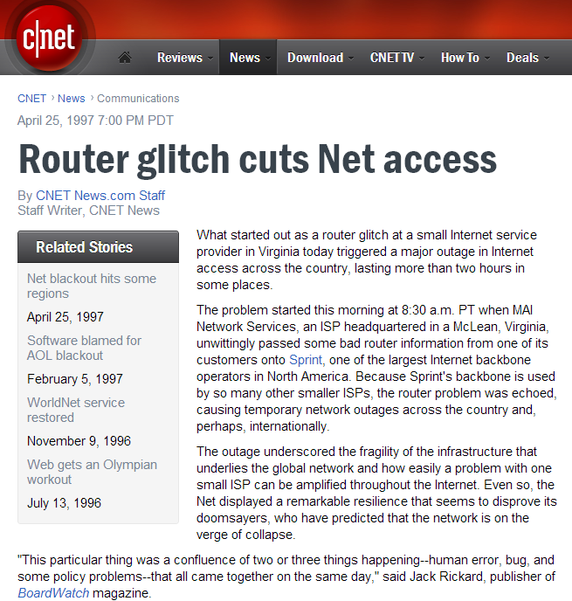

Slide 28
Local Actions, Global Consequences
“…a glitch at a small ISP… triggered a major outage in Internet access across the country. The problem started when MAI Network Services...passed bad router information from one of its customers onto Sprint.” -- news.com, April 25, 1997
UUNet
Sprint
MAI Network Services

Slide 29
Goal #5: Cost Effectiveness
Packet headers introduce high overhead
End-to-end retransmission of lost packets
  Potentially wasteful of bandwidth by placing burden on the edges of the network
Arguably a good tradeoff. Current trends are to exploit redundancy even more.

Slide 30
Goal #6: Ease of Attachment
IP is “plug and play” Anything with a working IP stack can connect to the Internet (hourglass model)
A huge success!
  Lesson: Lower the barrier to innovation/entry and people will get creative (e.g., Cerf and Kahn probably did not think about IP stacks on phones, sensors, etc.)
But….
Tradeoff: Burden on end systems/programmers.

Slide 31
Goal #7: Accountability
Note: Accountability mentioned in early papers on TCP/IP, but not prioritized
Datagram networks make accounting tricky.
  The phone network has had an easier time figuring out billing
  Payments/billing on the Internet is much less precise
Tradeoff: Broken payment models and incentives.

Slide 32
What’s Missing?
Security
Accountability (the other kind)
Support for disconnected/intermittent operation
Mobility
…

